Slide 1
Japanese NLP
John Knox – 2019/04/10

Slide 2
Japanese NLP
This will be very high level discussion of processing Japanese text
Illustrate some of the challenges faced with Japanese
Take an inventory and provide description of tools available
Meant to be broad, with many alternatives available
Not critiquing to say any one package is better than another
I won’t be demoing any fancy project or going into any deep implementation details

Slide 3
Challenges (Language)
Tokenization is not trivial:
No whitespace, three character sets that may or may not indicate boundaries
これは私の日本語教科書じゃありません。
すもももももももものうち
Orthography somewhat loosely coupled with pronunciation, most Chinese characters have at least two pronunciations (Chinese-origin, Native-Japanese-Origin)
Same word may be written differently, with same meaning & pronunciation (e.g. 猫, ねこ, ネコ)
Null subjects very common, many words omitted when clear from context (to humans)
Word order is normally and nominally SOV, but in practice, relatively free word order, appended particles (essentially postpositions) determine a word’s role within a clause.
Many distinct dialects with very marked variations (e.g. Tokyo’s “-nai”, & Kyoto’s “-hen”), politeness, register, etc. also dramatically change an utterance with similar meaning.
Casual language very prone to coining new words, chopping and abbreviating existing ones

Slide 4
Challenges (Practicalities)
Mojibake (⽂字化け)
Encoding issues EUC (old standard), ISO-2022-JP, Shift-JIS (code page 932, old web standard), UTF-8
Tools compiled or configured differently might mangle each other’s output
Windows can be very finicky, CMD / PowerShell / Git-bash may all work differently
Somewhat less support from many well established resources:
No spaCy model (but supposed to support NE recognition, tokenization via MeCab)
CoreNLP (officially supports Chinese, but not Japanese, though see this project)
NLTK (only a couple corpora, and a few tools built in)
KNB Corpus
JEITA Corpus
Google Japanese Web N-gram project (exists, but behind paywall / subscription)
Often little to no English documentation available (and what exists is often very asymmetric)
Mixed to poor Windows support for many packages
Older packages are showing some link rot

Slide 5
Segmentation, Tokenization, POS tagging, Stemming, Morphological Analysis
These packages tend to take care of all of these tasks simultaneously
JUMAN, JUMAN++ - Originally hand-built and tweaked, works with KNP parser. JUMAN++ is a faster, more accurate rebuild, based on a neural net
ChaSen – forked from JUMAN, but trained (Hidden Markov Models), older
MeCab – very popular package, forked from ChaSen, trained (Conditional Random Fields), works with CaboCha parser
KyTea – trained SVM, independent origin
Nagisa – another newer, independent tokenizer, based on a neural net
Output often in the form of frames or “lattices”

Slide 6
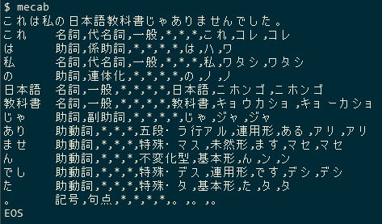
Example MeCab output:

Slide 7
Morphological Analysis Output (cont.)
Pros:
Rich output
Segments & tokenizes words
Provides detailed parts of speech
Provides pronunciation / kana-level (syllable-level) transcription
Provides stemmed and lemmatized output
Provides the conjugation of verbs and adjectives where available
Cons:
Maybe more information than you necessarily need if simply tokenizing?
POS and conjugation labels require you to know Japanese linguistic terms

Slide 8
Example MeCab output:
surface value
part of speech
part of speech, subtype 1
part of speech, subtype 2
part of speech, subtype 3
conjunction type
conjugation form
lexical form
written form
pronunciation

Slide 9
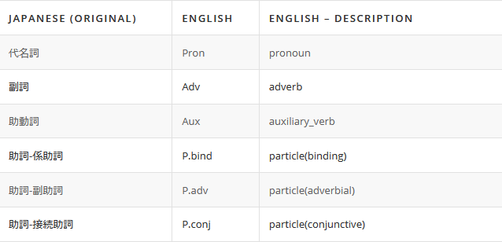
POS Tagsets (with English glosses)
ChaSen part-of-speech tagset
MeCab part-of-speech tagset
Another Japanese-English POS reference

Slide 10
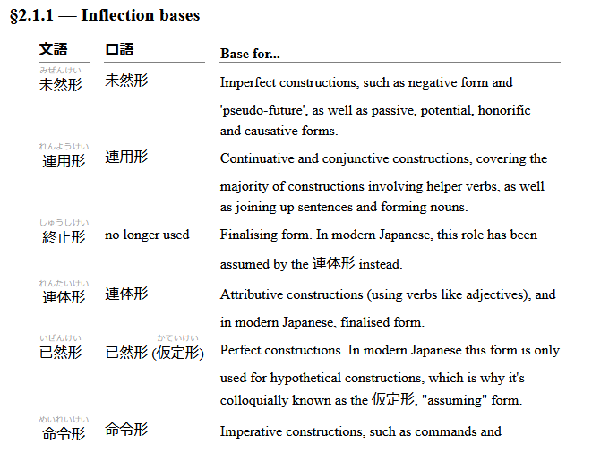
Verb Inflections
From An Introduction to Japanese: Syntax, Grammar & Language,
Kamermans (2005)

Slide 11
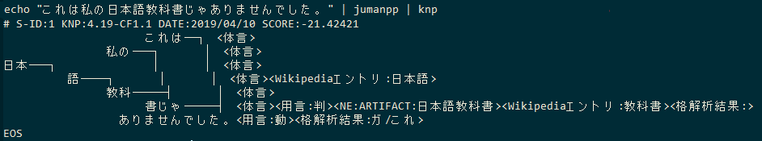
Dependency Parsing, NE Recognition
KNP Parser (Kurohashi-Nagao-Parser), developed in parallel with large treebank, manually examined and corrected
CaboCha, trained (Conditional Random Fields)

Slide 12
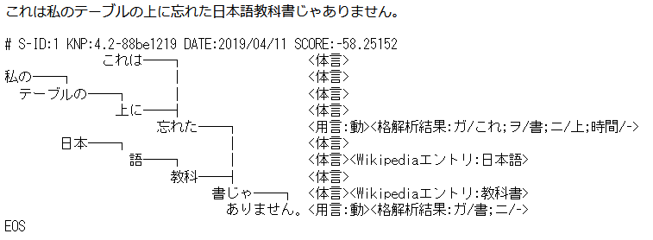
Dependency Parsing, NE Recognition

Slide 13
Python Wrappers
MeCab-python
CaboCha (official wrapper, needs compiled, dislikes Windows)
cabocha (wraps official wrapper, supposedly friendlier API)
PyKNP (official wrapper for KNP, JUMAN, JUMAN++)
Janome (self-encapsulated, with MeCab, IPAdict & NEologd)
JapaneseTokenizers (wraps MeCab, JUMAN, JUMAN++, KyTea)
natto-py (wraps MeCab)
jProcessing (stuck written for Python 2), but includes wrappers for EDICT, Japanese WordNet, and sentiment analysis in addition to CaboCha

Slide 14
Dictionaries / Lexicons
(These are mostly packaged with / baked into tools)
JUMANDIC - Cultivated alongside JUMAN project
IPAdict - Information-technology Promotion Agency not that IPA
mecab-ipadic-NEologd – Frequently refreshed dictionary of neologisms from the web (for MeCab, supplements IPAdict)
UniDic – intended to split words to smallest meaningful morphemes, includes language origin (native, Sino-Japanese, foreign, mixed)
BCCWJ Word List – From balanced corpus, includes frequencies
EDICT – Japanese - English (and other languages) dictionaries

Slide 15
Corpora
From NLTK:
KNB Corpus (Annotated blog corpus)
JEITA Public Morphologically Tagged Corpus (in ChaSen format)
ChaSen format Corpus Reader
A Guide to NLTK’s Japanese resources
"The Balanced Corpus of Contemporary Written Japanese" (BCCWJ) – only web resources freely available, includes many domains of language
Aozora Bunko – copyright-free Japanese literature
Tanaka Corpus – parallel Japanese-English corpus

Slide 16
Resources
Kurohashi & Kawahara Lab
(JUMAN, JUMAN++, KNP)
Resources for Natural Language Processing (includes several corpora)
Nara Institute of Science and Technology Matsumoto Laboratory
(ChaSen, MeCab, CaboCha)
Readings in Japanese Natural Language Processing, Bond & Baldwin (2016), ISBN:9781575867533 – general information on language & NLP efforts
An Introduction to Japanese: Syntax, Grammar & Language, Kamermans (2005), ISBN: 9789081507110
NLTK Japanese Language Processing (KNB & JEITA corpora)
Chapter from NLTK book on Japanese NLP (in Japanese)

Slide 17
General Resources
Association for Natural Language Processing in Japan
Association for Computational Linguistics (ACL) – Resources for Japanese
Natural Language Processing Portal (by JEITA)
Gengo Shigen Kyōkai (GSK) “Language Resource Association” – many dictionaries / corpora largely for pay and/or behind membership
Japanese Text Analysis: Overview – wide list of resources from UPenn
Most of these are cribbed from Bond & Baldwin (2016)

